Slide 1




Slide 2


Agenda
About SFMC Triggered > Braze API Send
Technical Requirements & System Flow
Result
Reference
Issue

Slide 3
About SFMC Triggered > Braze API Send

Slide 4
What is SFMC Triggered > Braze API Send
This project was initiated by Sephora team because they had problems with the custom integration of Braze in Salesforce Marketing Cloud.
Initially, Braze can be used in the Journey of SFMC, however, due to some reasons, it’s not working anymore so we had to find a way to make it still works in a way that whenever the Journey runs, it could still trigger the Braze send.
Sephora team found a way to still make it work by triggering the send through Automation Studio’s Script node using SSJS to trigger the send from SFMC Automation.
Ematic will help to spread the information to the whole team so that this process could be used whenever Sephora team needs Braze to be triggered in SFMC.

Slide 5
Technical Requirements

Slide 6
Technical Requirements
To build a campaign in Braze
To be able to send the campaign through SFMC
To build a script in the Automation
Initialize a Target Data Extension
Able to pull the fields needed in the Braze campaign
Initialize the logs DE
Able to log the messages from API response
Trigger the send from the script using HTTP.Post

Slide 7
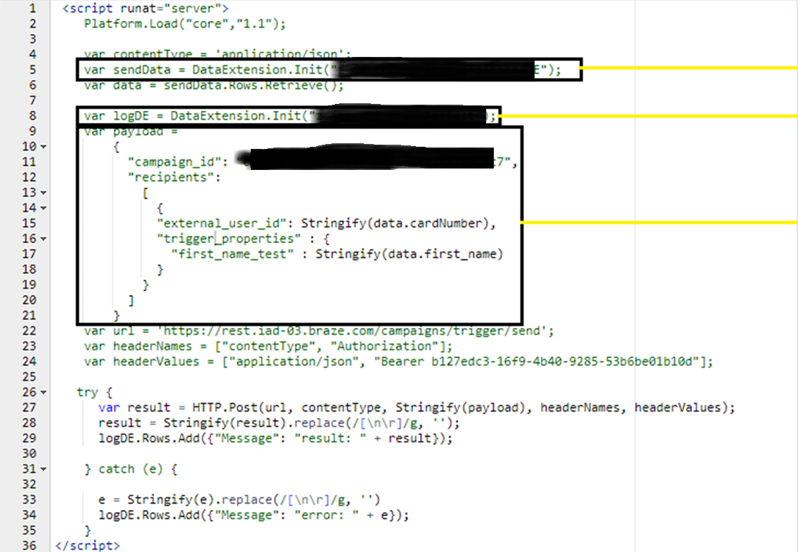
Script Setup
Data Extension that contains the Target
Data Extension that contains the Send Logs
API Payload that is needed for the API Triggered Send, this could change depending on the data requirements of the campaign

Slide 8
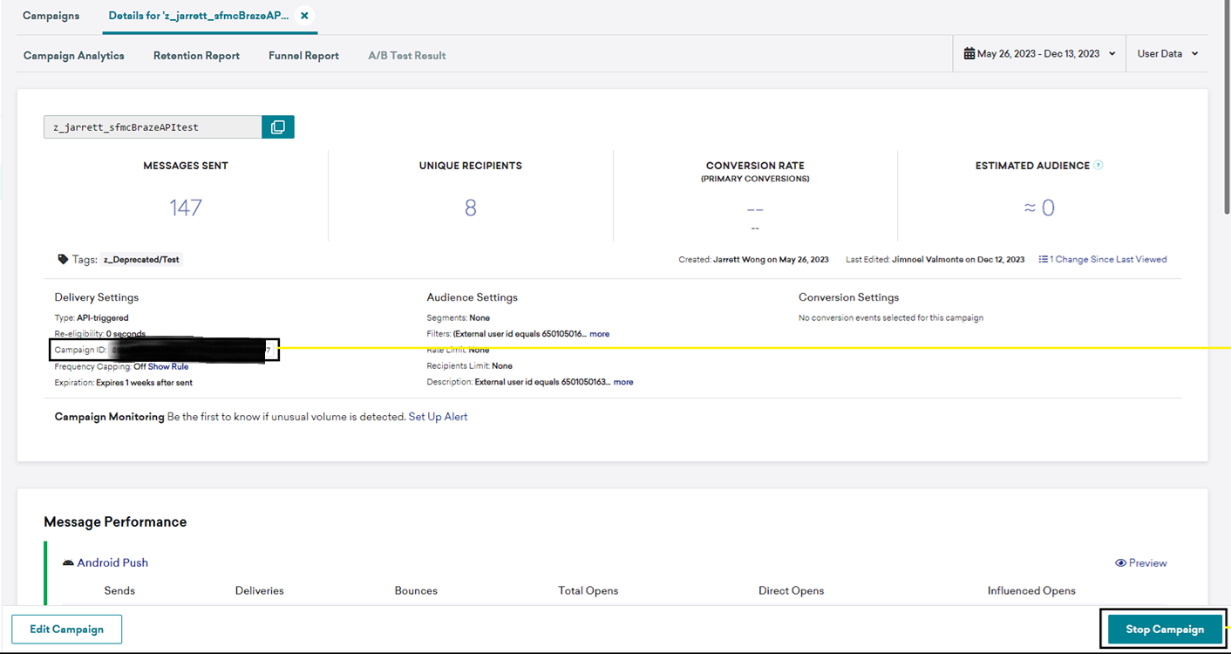
Braze Campaign Setup
Campaign ID will be used in the Script Setup
Braze campaign has to be active for the script to successfully trigger a send

Slide 9
Reference

Slide 10
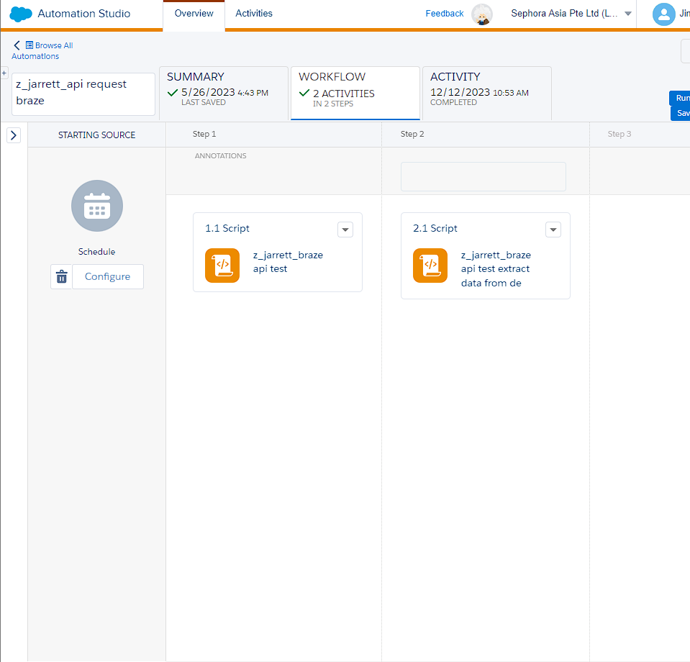
Jarrett’s Setup
Business Unit: Sephora Asia Pte Ltd
Automation Name: z_jarrett_api request braze
Query Name: z_jarrett_braze api test extract data from de
Target DE: Data Extensions > Test > z_jarrett_brazeApiTestSendDE
Logs DE: Data Extensions > Test > z_jarrett_brazeApiTest

Slide 11
Issues

Slide 12
Table of Issues
Title | Issue | Date

Slide 13

THAT’S IT! THANK YOU!

